Slide 1
LAB 1 INTRODUCTION TO VHDL
FACULTY OF ENGINEERING
CAIRO UNIVERSITY
CMPN301: COMPUTER ARCHITECTURE COURSE
EXERTED FROM DR. ADNAN SHAOUT- THE UNIVERSITY OF MICHIGAN-DEARBORN

Slide 2
DESIGN FLOW
HDL Design
Computer Architecture
Behavioral Simulation
Leonardo
Synthesis
Post-Synthesis Simulation
Modelsim
Floor Planning
IC Station
Placement
Routing
Calibre
DRC / LVS
Post- Route Simulation
Fabrication
Notes:
Synthesis:
Translating the HDL code into a circuit, which is then optimized
Register Transfer Level (RTL):
Type of behavioral model used for instance for synthesis

Slide 3
OBJECTIVES
Define VHDL and its usage
Understand different modeling techniques in designing digital circuits (Dataflow , structural)
Understand the Hardware created from the VHDL code
Understand Concurrent statement
Reuse previously created entity (component instantiation a.k.a port mapping)
Practice designing with VHDL

Slide 4
WHAT IS VHDL?
VHSIC Hardware Description Language
VHDL is a programming language that allows one to model and develop complex digital systems.

Slide 5
WHY VHDL?
Requirements specification
Documentation
Testing using simulation
Formal verification
Synthesis
Class assignments ☺

Slide 6
HW DESIGNER GOAL
Most ‘reliable’ design process, with minimum cost and time.
Avoid design errors!

Slide 7
VHDL is Describing Hardware so every line counts and cost a lot in real world

Slide 8

VHDL LANGUAGE: VARIABLES
Variables are Wires
Assignment are “<=” or “:=” instead of “=”
X <= C and D;
W <= E nor F;
C
X
D
AND
E
W
F
NOR

Slide 9
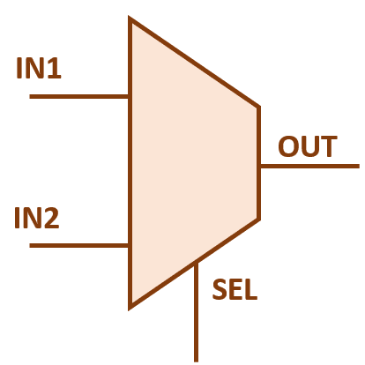
VHDL LANGUAGE: MODEL DEFINITION
Images are from http://vlsiuniverse.blogspot.com.eg/2016/07/multiplexer.html

Slide 10
VHDL LANGUAGE: MODEL DEFINITION …(CONT)
Modules
Models
Entities
Components
System
entity name
port names
port mode (direction)
ENTITY mux2 IS PORT ( IN1,IN2,SEl : IN std_logic; OUT1 : OUT std_logic); END ENTITY mux2;
reserved words
port type
punctuation

Slide 11
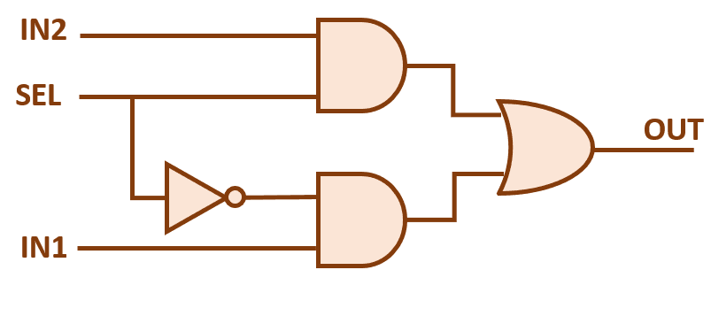
VHDL LANGUAGE: MODEL IMPLEMENTATION
ARCHITECTURE arch1 OF mux2 IS
BEGIN
out1 <= (in1 and (not Sel))
or
(in2 and Sel);
END arch1;

Slide 12
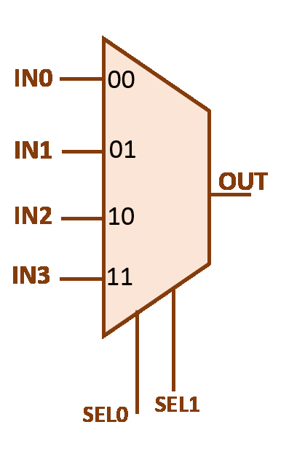
LET’S MAKE A MUX 4X1

Slide 13
MUX 4X1
ENTITY mux4 IS
PORT( in0,in1,in2,in3: IN std_logic;
sel : IN std_logic_vector (1 DOWNTO 0);
out1: OUT std_logic);
END mux4;

Slide 14
VHDL LANGUAGE: MODEL IMPLEMENTATION
MODEL Implementation is called Architecture
Types of Modeling:
Dataflow
Describes the flow of data within a component/system.
Structural
Describes the component by the interconnection of lower level components/primitives
Behavioral (next time)
Describes the functionality of a component/system usually using a process
Mixed of the above ways
Notes:
there is no clear distinction between behavioral model and Dataflow
check this link http://stackoverflow.com/questions/18682019/confusion-between-behavioural-and-dataflow-model-programs-in-vhdl
-- this part is for understanding how to think of the design

Slide 15
VHDL LANGUAGE: MODEL IMPLEMENTATION DATA FLOW
ARCHITECTURE arch1 OF mux4 IS
BEGIN
out1 <= in0 WHEN sel(0) = ‘0’ AND sel(1) =‘0’
ELSE in1 WHEN sel(0) = ‘0’ AND sel(1) =‘1’
ELSE in2 WHEN sel(0) = ‘1’ AND sel(1) =‘0’ ELSE in3;
END arch1;

Slide 16
VHDL LANGUAGE: MODEL IMPLEMENTATION STRUCTURAL
Can we Make Mux 4x1 from Mux 2x1 ?

Slide 17
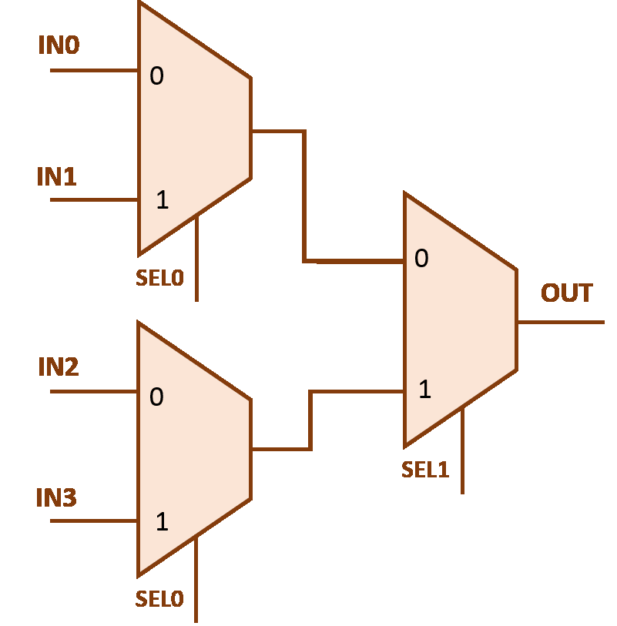
VHDL LANGUAGE: MODEL IMPLEMENTATION STRUCTURAL

Slide 18
VHDL LANGUAGE: MODEL IMPLEMENTATION STRUCTURAL
When we use another entity inside our architecture we call it component
ARCHITECTURE struct OF mux4 IS
COMPONENT mux2 IS PORT (IN1,IN2,SEl: IN std_logic; OUT1 : OUT std_logic); END COMPONENT ;
SIGNAL x1,x2 : std_logic;
Begin
Signal are considered as wires
Signal type Notice there is no direction for signals

Slide 19
VHDL LANGUAGE: MODEL IMPLEMENTATION STRUCTURAL
When we use another entity inside our architecture we call it component
ARCHITECTURE struct OF mux4 IS
COMPONENT mux2 IS PORT (IN1,IN2,SEl: IN std_logic; OUT1 : OUT std_logic); END COMPONENT ;
SIGNAL x1,x2 : std_logic;
Begin
Till here we told our circuit that there is a component called mux2 and this is how to connect to it but we didn’t use it yet
Signal are considered as wires
Signal type Notice there is no direction for signals

Slide 20
VHDL LANGUAGE: MODEL IMPLEMENTATION STRUCTURAL (CONT)
Keyword , whenever I port map a component
I put it in the circuit (as hardware IC)
BEGIN
u0: mux2 PORT MAP (in0,in1,s(0),x1);
u1: mux2 PORT MAP (in2,in3,s(0),x2);
u2: mux2 PORT MAP (x1,x2,s(1),out1);
END struct;
Label to identify component with while tracing
Concurrent statements
All executes at the same time
Component name
Parameters sent to the component in the same order they are mentioned in the declaration

Slide 21
VHDL LANGUAGE: MODEL IMPLEMENTATION STRUCTURAL (CONT)
BEGIN
u0: mux2 PORT MAP (in0,in1,s(0),x1);
u1: mux2 PORT MAP (in2,in3,s(0),x2);
u2: mux2 PORT MAP (x1,x2,s(1),out1);
END struct;

Slide 22
VHDL LANGUAGE: MODEL IMPLEMENTATION STRUCTURAL (CONT)
ENTITY gate_logic IS
PORT( A,B,: IN std_logic;
C: OUT std_logic);
END gate_logic;

Slide 23
VHDL LANGUAGE: MODEL IMPLEMENTATION STRUCTURAL (CONT)
ARCHITECTURE and_gate OF gate_logic IS
BEGIN
c <= a AND b;
END and_gate;
ARCHITECTURE or_gate OF gate_logic IS
BEGIN
c <= a OR b;
END or_gate;

Slide 24
VHDL LANGUAGE: MODEL IMPLEMENTATION STRUCTURAL (CONT)
ENTITY gates IS
PORT( in0,in1,in2,in3: IN std_logic;
out1, out2: OUT std_logic);
END gates;

Slide 25
VHDL LANGUAGE: MODEL IMPLEMENTATION STRUCTURAL (CONT)
ARCHITECTURE struct OF gates IS
COMPONENT gate_logic IS PORT (A,B: IN std_logic; C : OUT std_logic); END COMPONENT ;
Begin
Till here we told our circuit that there is a component called gate_logic and this is how to connect to it but we didn’t use it yet

Slide 26
VHDL LANGUAGE: MODEL IMPLEMENTATION STRUCTURAL (CONT)
BEGIN
and1: work.gate_logic(and_gate) PORT MAP (in0,in1,out1);
or1: work.gate_logic(or_gate) PORT MAP (in2,in3,out2);
END struct;

Slide 27
DATA TYPE (STD_LOGIC)
Include
Library ieee;
Use ieee.std_logic_1164.all
Std_logic Possible values
1 or 0
X → for conflict
Z → high impedance (remember tristate buffer?)
U → undefined
others
Think: What do you think possible values of Data Type (bit) ?
Which is better to use bit or std_logic?

Slide 28
DATA TYPE (STD_LOGIC_VECTOR)
Std_logic_vector
a,b : in std_logic_vector(2 downto 0)
Can be accessed like b(2) , b(1)
To access all vector
a <= b;
To access a range of the vector
b(1 downto 0) <= a(2 downto 1)
‘&’ operator to concatenate two vectors or vector and single element
b(1 downto 0 ) <= a(2) & ‘0’

Slide 29
Still confused !!
Consider the module as a function or class
The entity declaration is like a header for the function (interface to our module)
The architecture is the implementation of the function (how this module behaves inside)
Whenever I want to use function in another , I have to include that function header (that’s when I introduce the module between architecture and begin)
The actual usage of the function happens when we call it – function call- this is like port mapping a component But …

Slide 30
Important Consideration
Whenever you use port map , you add a component to the circuit , it is not like a function that you can call it and re-call it. so in our previous example we had 3 mux2 components (i.e. 3 ICs on the breadboard).
Since port mapping is physical insertion of hardware it can’t be made in a condition (i.e. x< = mux2 port map(…) when A=‘0’ ; is totally incorrect)
Unlike software , VHDL statement are concurrent , they all execute in the same time not after each other (unless in certain cases to be mentioned later)

Slide 31
OBJECTIVES
Define VHDL and its usage
Understand different modeling techniques in designing digital circuits (Dataflow , structural)
Understand the Hardware created from the VHDL code
Understand Concurrent statement
Reuse previously created entity (component instantiation a.k.a port mapping)
Practice designing with VHDL

Slide 32
TIPS
Always Save & Compile before simulation.
Read the Error/Warning messages in “Transcript” tap.
Change the “Radix” to make the simulation easier (right click on signal name in simulation).
Re-writing your code all over again will NOT solve your problems.
For any Error, check the few lines before the line with error message.
Always use Do files instead of Changing the inputs every time.

Slide 33
DEMO#1
Create Project
Add files to project (and.vhd)
Compile (Fix Errors)
Simulate (force, clock, do)

Slide 34
SUMMARY
What is VHDL?
Why VHDL
Entity/Architecture
Modeling using (Dataflow , structural)
Data types in VHDL (std_logic / bit & std_logic_vector / bit_vector)
Code is Concurrent not sequential
Signals are wires
Resuing previously created entity (component instantiation a.k.a port mapping)

